Slide 1
Recspicy /Simple yet elegant/
James McGuigan & Steven Foster

Slide 2
Design Overview
Assumptions
Constraints
Risks

Slide 3
Assumptions
Our Purpose
Simple yet elegant in design and in theory?
New recipes powered by the people!

Slide 4
Constraints
Who is our intended audience?
Why we are making this?
What are our intentions?

Slide 5
Risks
Who is our intended audience?
Why we are making this?
What are our intentions?

Slide 6
Detailed Design
Data Models and Database Design
Data Models
Data Dictionary
Database Schema
User Interface
Structure and Navigation
Screen Descriptions
API Development

Slide 7
Non-Functional Requirements

Slide 8
Tests

Slide 9
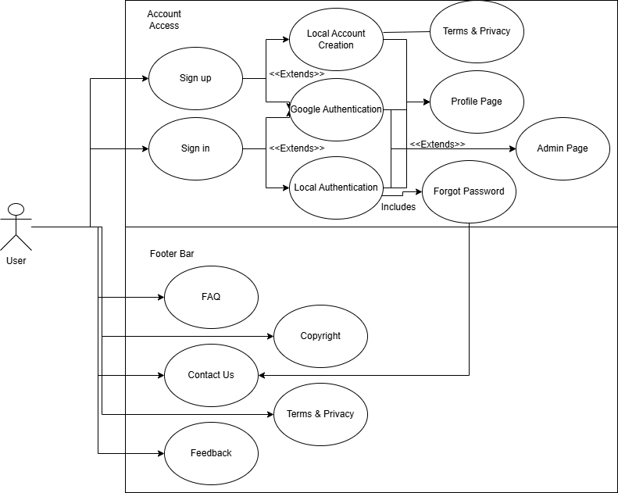
Use Case 1: Welcome Page
Welcome/ Landing page
Introduce the website
Include a design and logo
Creation of accounts
Available sections
sign in
sign up
Footer navigation
What pages user can navigate and visit.

Slide 10
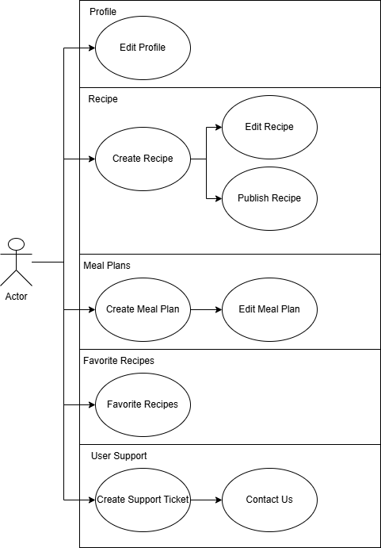
Use Case 2: Profile
From our Landing page, we intend to…
This is how our profile will be structured.
User will have the ability to update this page.
Users will have these features as intended inclusion from our website.
Profiles will be uniform in design yet unique to users preference.
This will be based off of features we will include in our design.

Slide 11
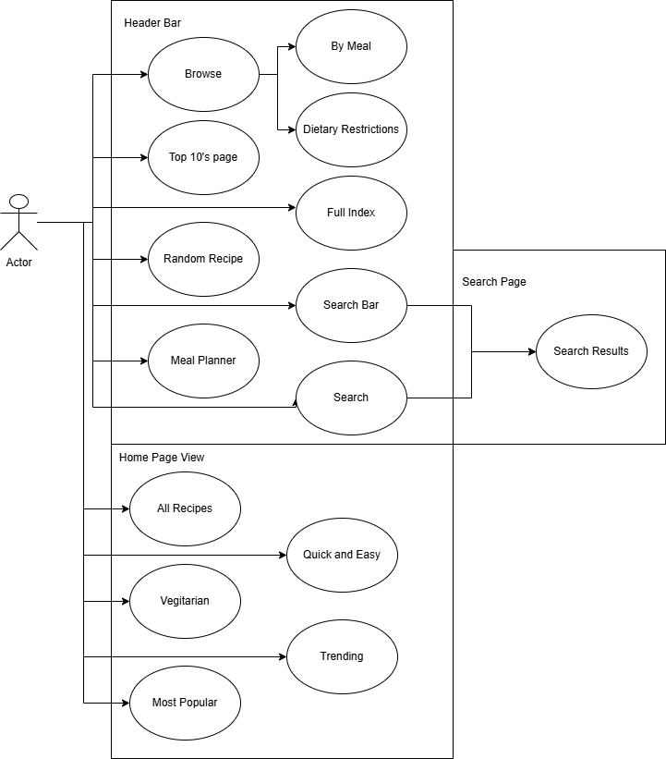
Use Case 3: Home Page
The base of our website.
Features and navigation included for our project.
Our purpose of include these things and not others.
How we intend users to utilize their profiles and our system.
Navigation bar and the home page.

Slide 12
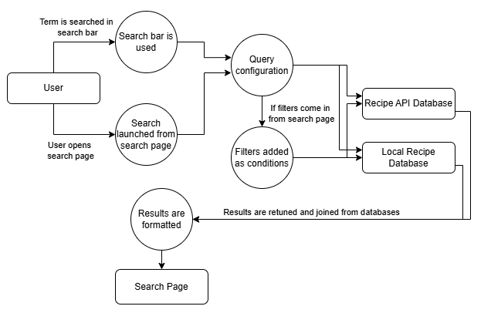
Use Case 4: Filtering
The purpose of our filters.
Why are we filtering in this way?
What the user can search?
API Recipes
Filters will be placed in the PHP
Stored Recipes
Filters will be placed in the recipe creation query and stored in arrays.
We will use check boxes.

Slide 13
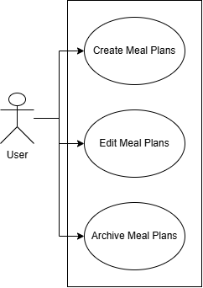
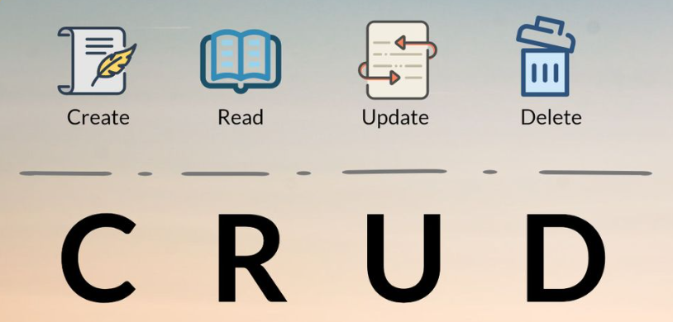
Use Case 5: Meal Planner
The user will Create a meal Plan
The user can Change the meal plan
The user can Update the meal plan
The user can Store the meal plan
The user can Delete the meal plan
Monday - Sunday
Inclusion of Nutrition API
Will filter information and provide nutrition facts

Slide 14
User Intended Actions
- The Landing Page
Welcome Message & Logo
Information, About Us
Our Features
Register / Sign-in
Footer Navigation
Additional pages

Slide 15
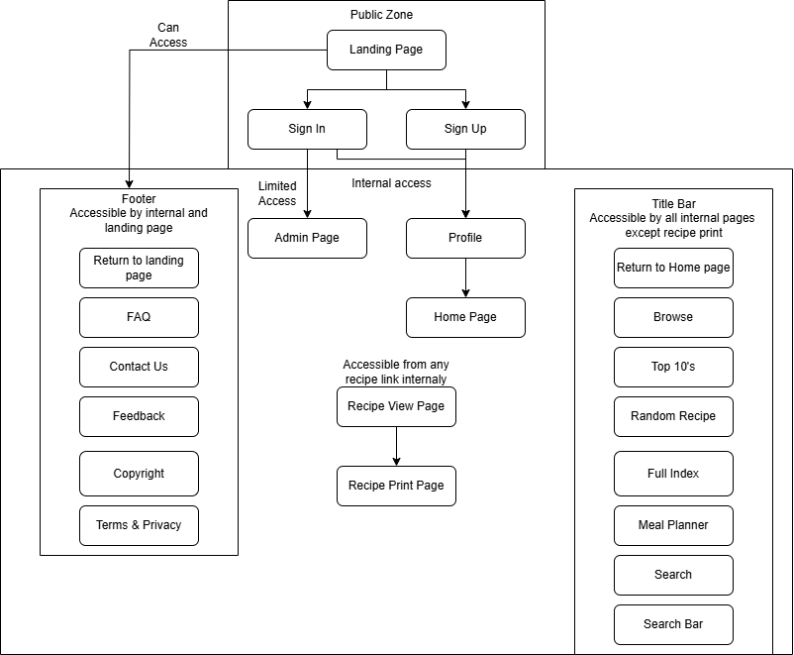
User Intended Actions - Entering the Website
What we want to see from the user.
Why we want to see these behaviors.
What we can do with this information.
Why feedback is so important.
Page tracking and analytics.

Slide 16
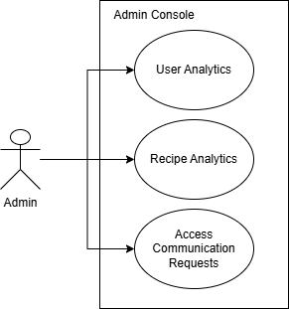
User Intended Actions
- The Admin Role
Our Admins Purpose
Assistance and user support.
Information:
Identification and gathering.
Feedback.
Database Management

Slide 17
Why record information if we aren’t currently using it?
well we are!
Data Analytics
Recipe tracking
Optimization
Performance
Advancement for a larger platform in the future
ratings = featured recipes
viewed pages = frequently visited
tags = optimized filters
user creations = growing support

Slide 18

The Product
~~~Recspicy~~~

